Slide 1


Slide 2
WELCOME!
The Guided Writing Retreat is a new feature of the Ohio Valley Shakespeare Conference designed to support scholars who may not have access to funded writing retreats at their institutions.
It is a quiet, focused environment for sustained writing in 75-minute blocks.
Before or between the sessions, there will be opportunities to network and share with colleagues.
Whether you’re revising an article, drafting a chapter, or developing a new project, we hope you can benefit from the retreat!
Notes:
EMAIL:
We’re excited to introduce the Guided Writing Retreat at this year’s Ohio Valley Shakespeare Conference! Recognizing that many institutions don’t provide support for writing retreats, this new feature creates a welcoming space for sustained writing time, collegial exchange, and informal networking. Please find attached the welcome slide deck. Any questions specific to the guided writing retreat, please reply to this email.

Slide 3
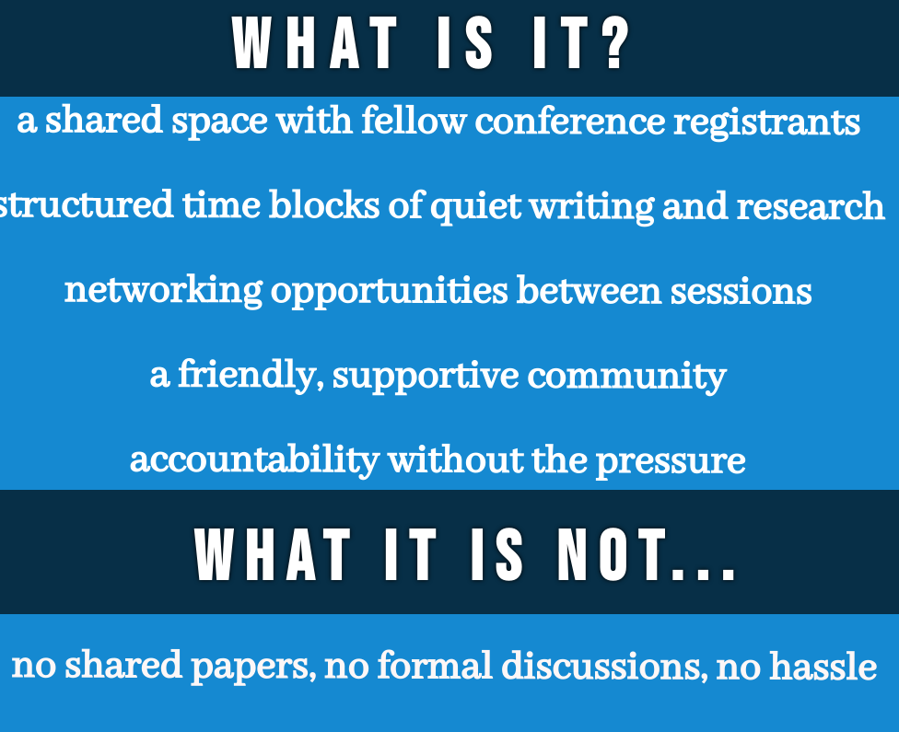

Slide 4


Slide 5
Thursday, October 16
1st session
2:00-3:45 pm
2:00-2:15 Gather and brief introductions
2:15-3:30 Quiet Work Time
Only research and writing allowed. No grading, emails, phone calls, or social media.
3:30-3:45 Opportunity to network and share projects

Slide 6
Thursday, October 16
2nd Session
4:00-5:30
4:00-4:15 Gather and brief introductions
4:15-5:30 Quiet Work Time
Only research and writing allowed. No grading, emails, phone calls, or social media.
5:30 Well deserved happy hour!

Slide 7
Friday, October 17
3rd Session
9:00-10:45am
9:00-9:15 Gather and brief introductions
9:15-10:30 Quiet Work Time
Only research and writing allowed. No grading, emails, phone calls, or social media.
10:30-10:45 Opportunity to network and share projects

Slide 8
Questions and feedback welcome!
Please email carol.mejia-laperle@wright.edu with your questions and feedback.

